Slide 1
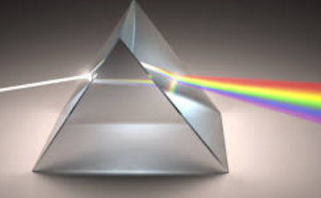
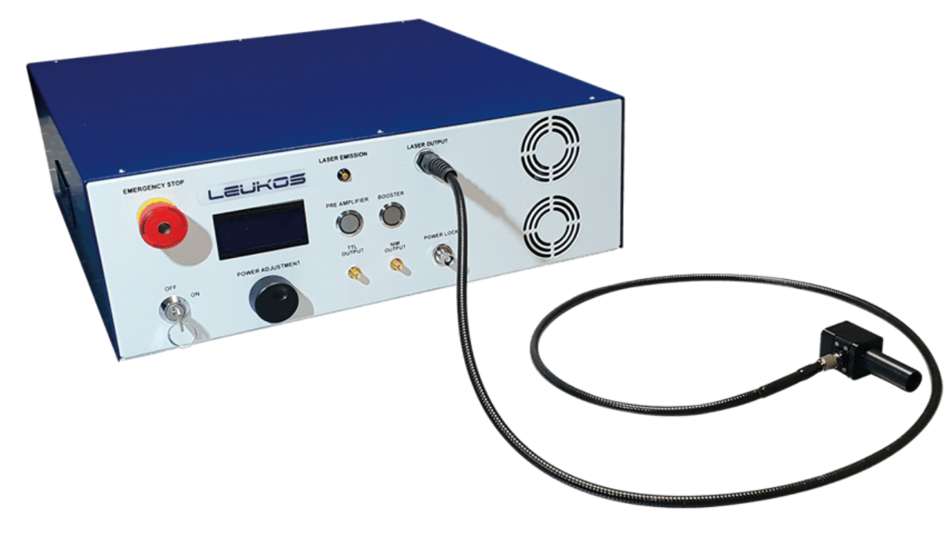
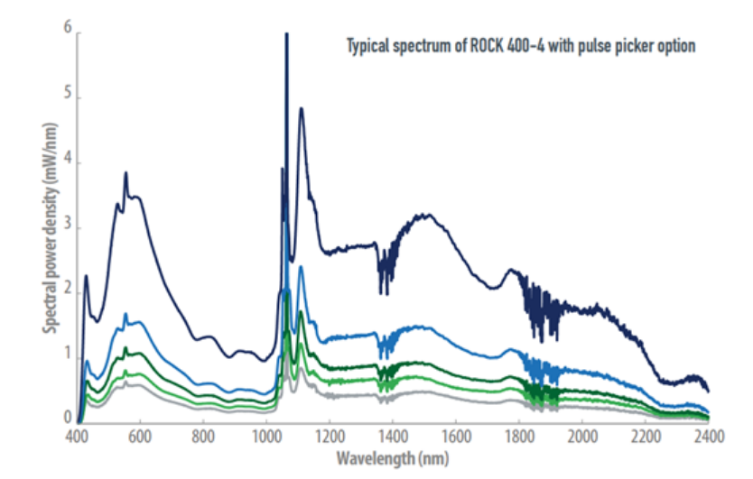
Using VR to show invisible light in a laser mapped in line segments - could be commercial or a patent
Pucong Li
16.12.2024

Slide 2
Content
1. Introducing myself
2. Thesis idea
3. Existing research work

Slide 3
Introducing myself
Writing skills(My basic skill): record my dreams without effort, other inspirations, 50,000 - 100,000 from 2023-2024
Financing skills: crypto investing, cheat money in Ponzi scheme
Music skills: 7-9 years
Drawing: 6 months - 1 year, wacom drawing tablet(blender sculpting)
Social Media: Bilibili, video websites like Youtube, gaming videos, my own photos
My other commercial/patent plans: about VR, hardware, AI and gaming

Slide 4


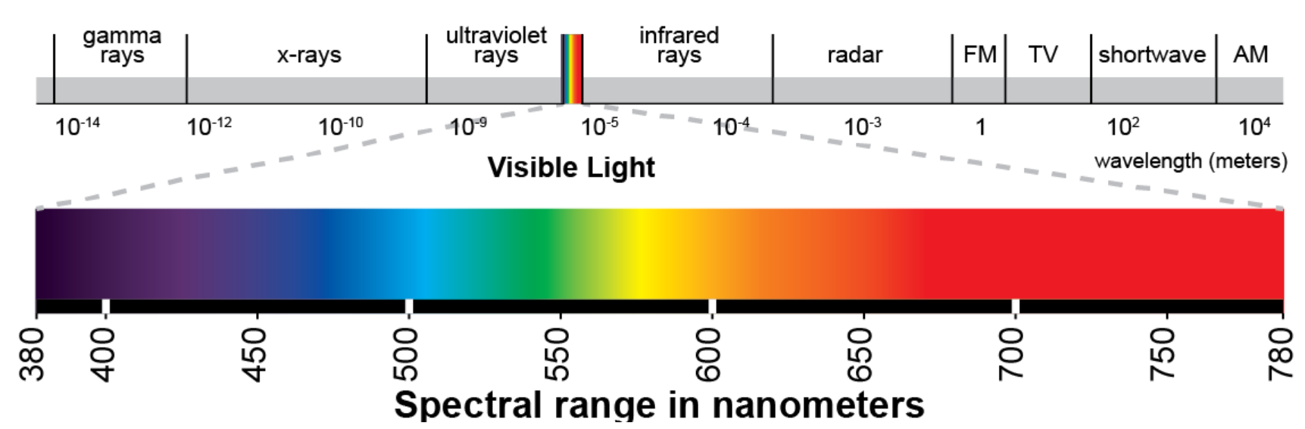


Thesis idea
Using VR to show what we can’t see in real world.
Completed rendering(very complex) → one supercontinuum laser
1. a new way to express non-visible light
10λ
10λ - 300nm
λ

Slide 5
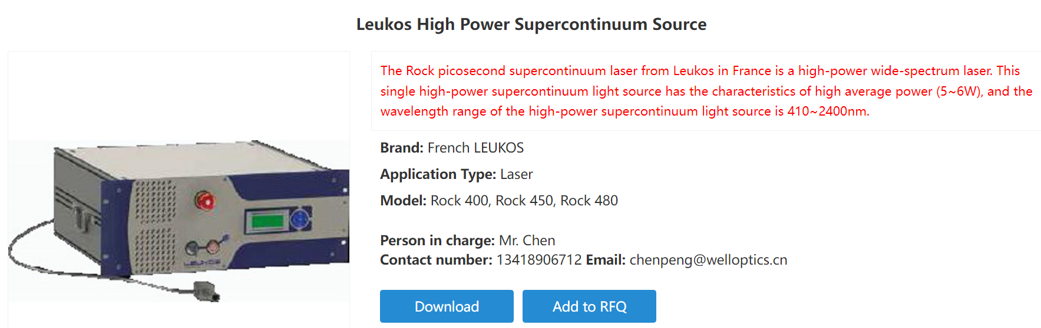
Thesis idea

Slide 6
Thesis idea

Slide 7
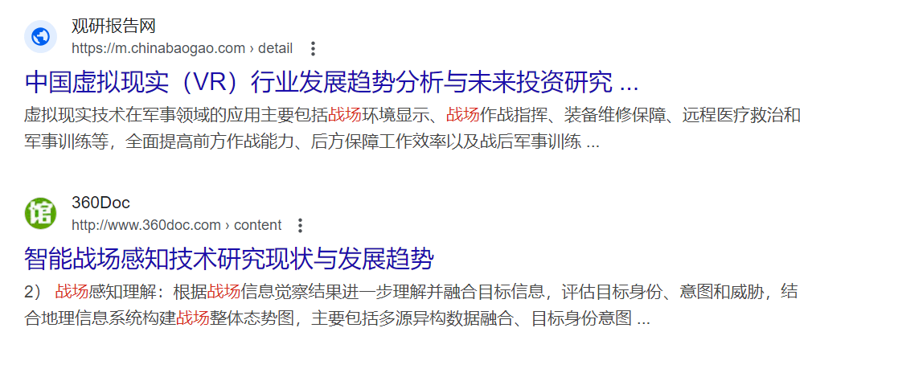
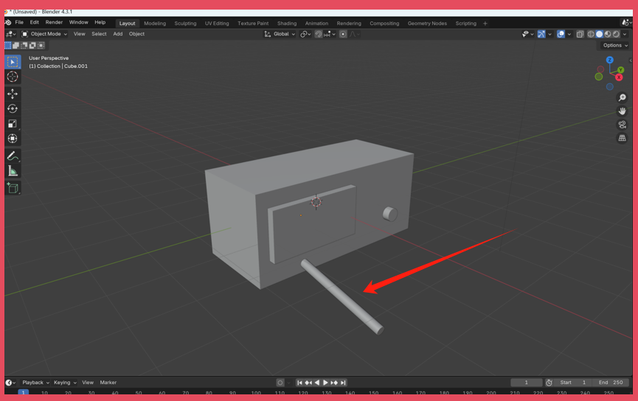
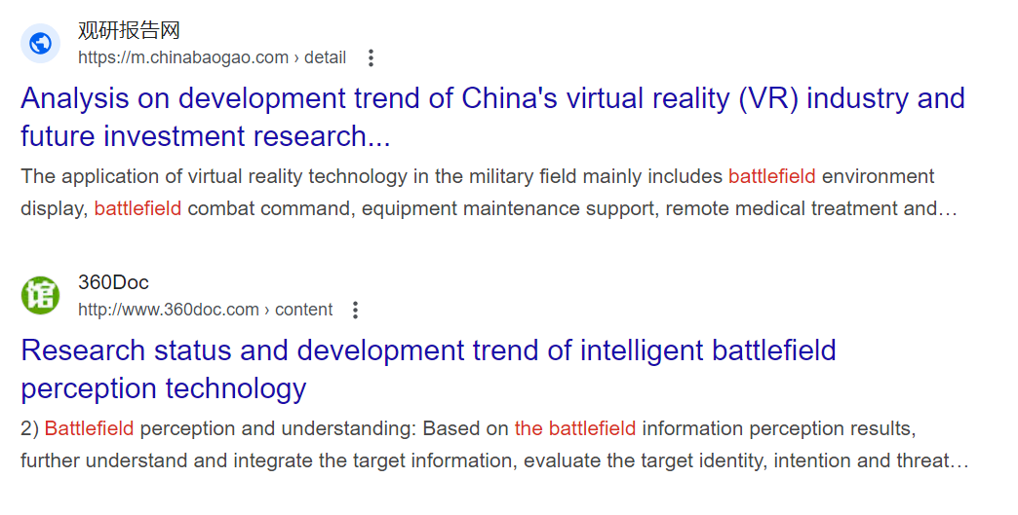
Thesis idea - demo
The sale procedure could be improved since a VR immersive presentation meybe can help researchers to feel the output of an invisible lasser and build intuition, in my imaginary → lead to animation. military factory ←→ civilian factory (games by Pradox, Iron of Heart 4)

Slide 8
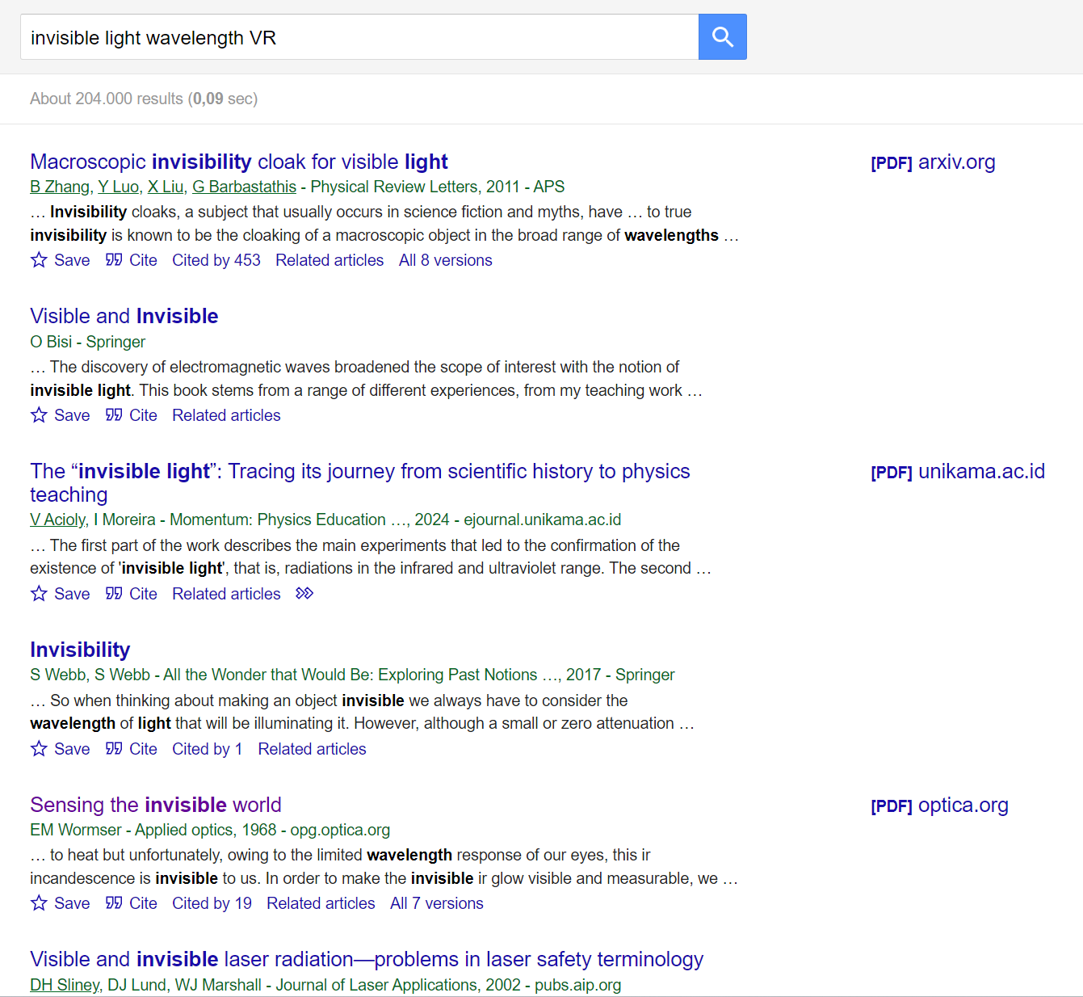
Existing research work
no papers about mapping

Slide 9
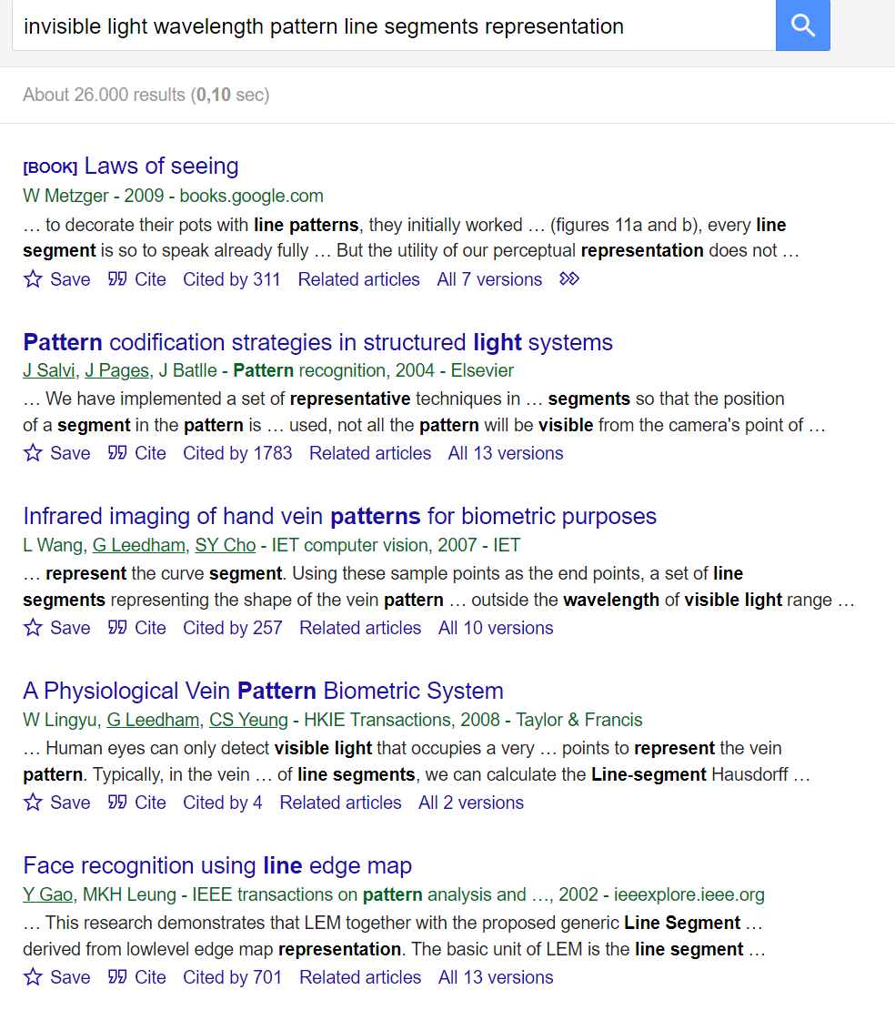
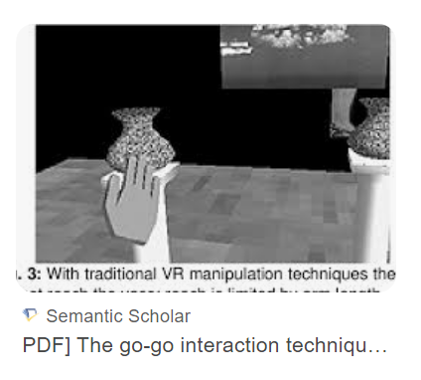
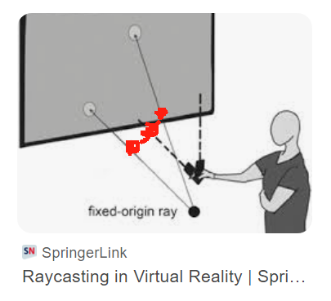
Existing research work

Slide 10
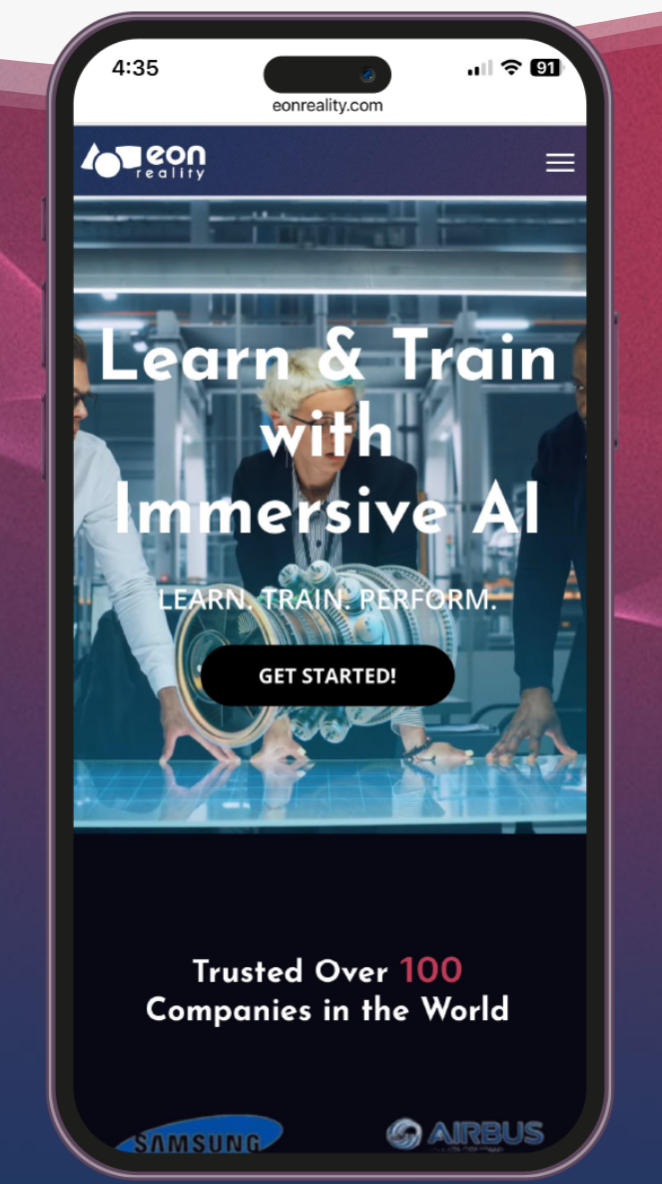
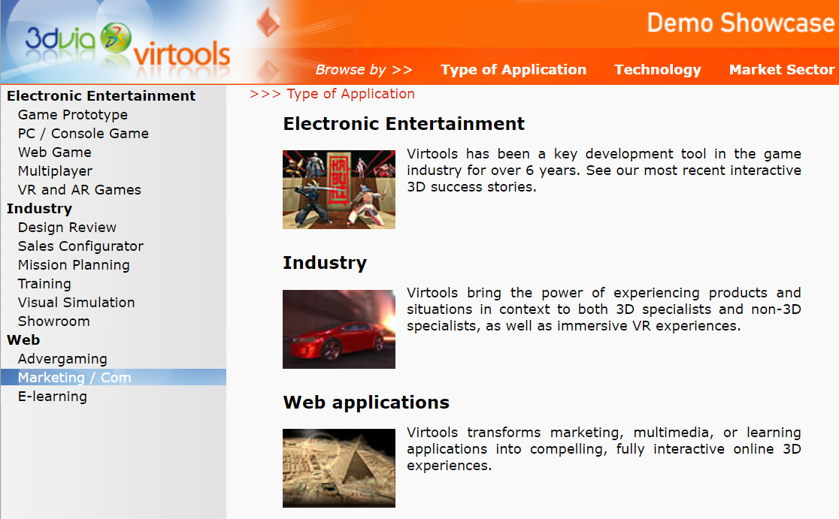
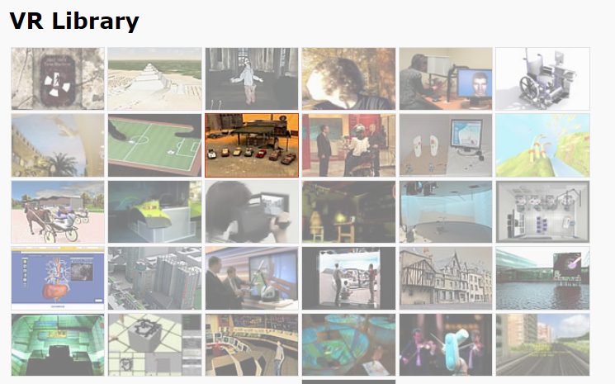
Existing research work
Optimization of VR tech in high school physics class(2022)

Slide 11
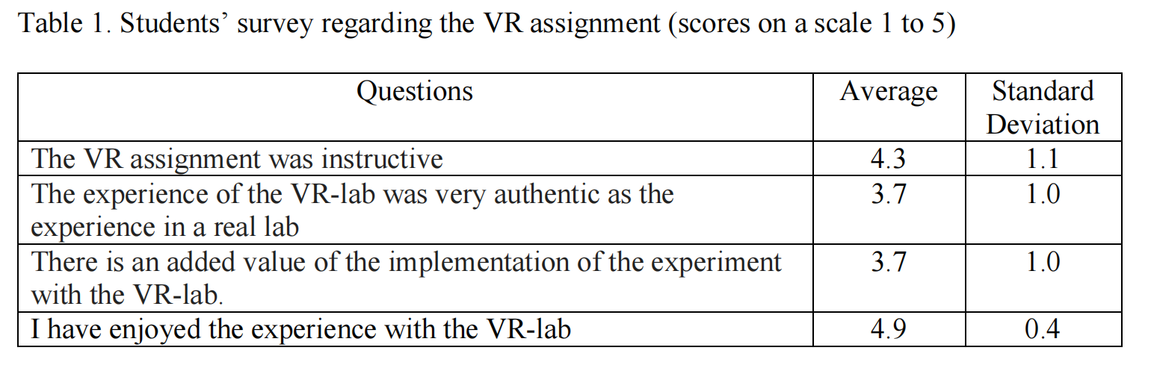
Existing research work
How good is VR teaching on optical measurement thought by students(2019)

Slide 12
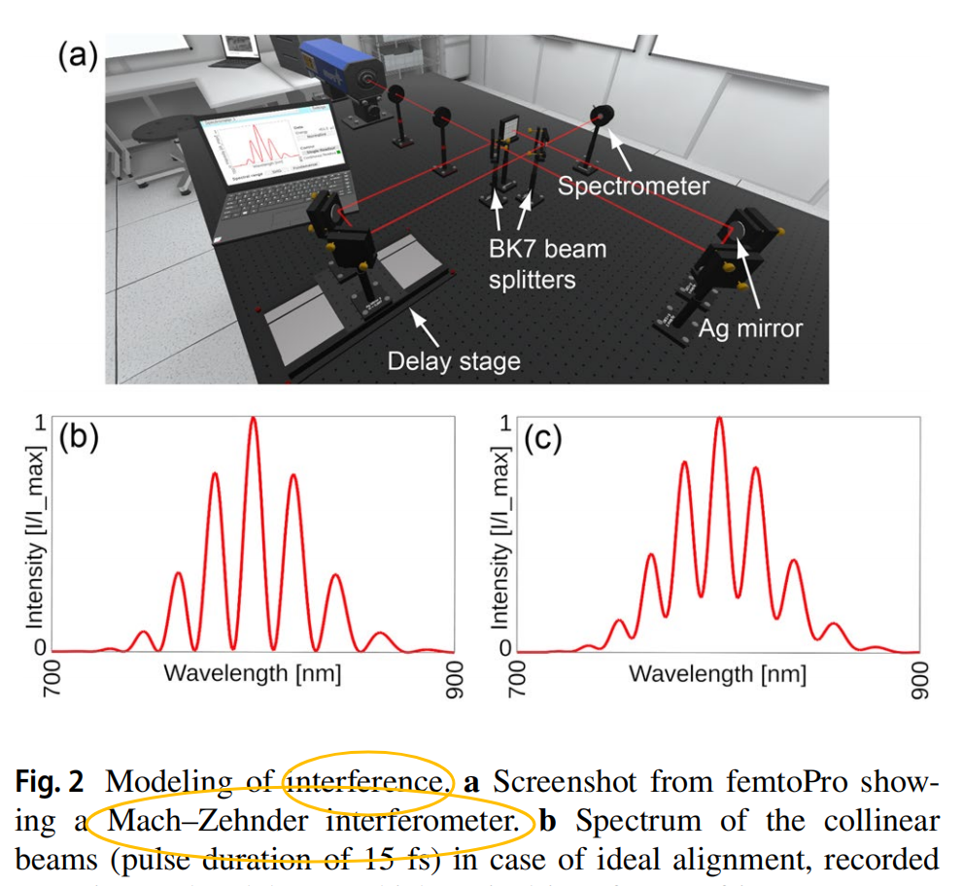
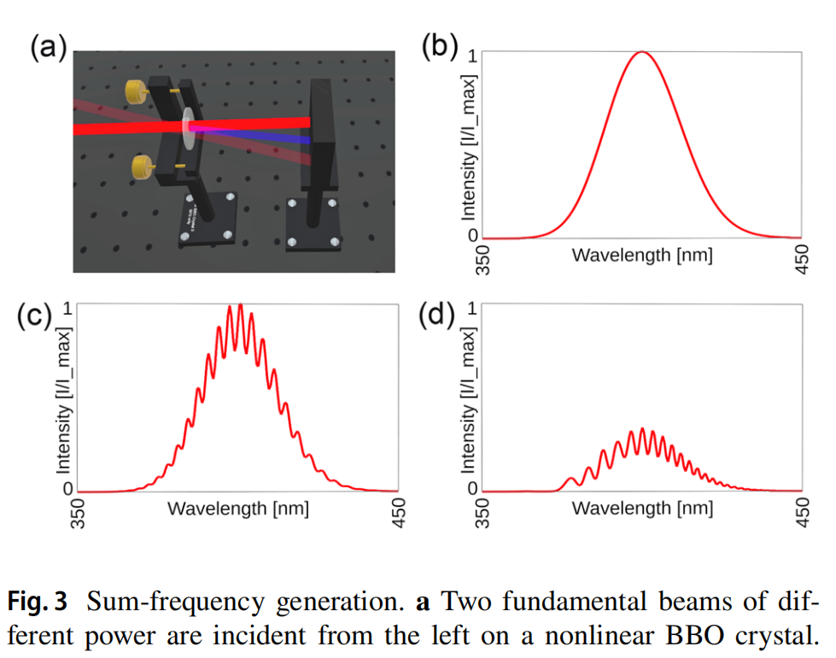
Existing research work
VR ultrafast laser library based on Unity and C#(2023)

Slide 13
Thank you for your attention!

